Slide 1
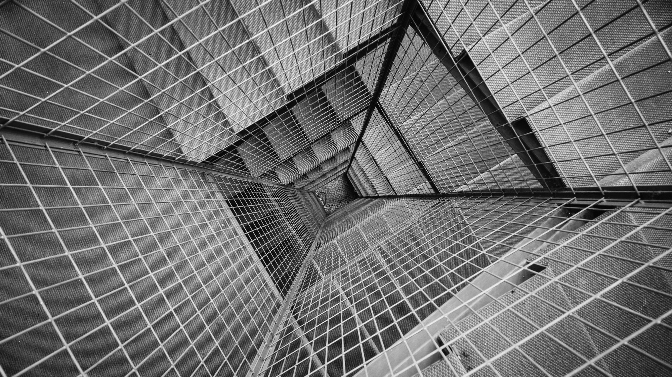
Hotel management system.
…………………………

Slide 2

by- rashika agrawal, apurva srivastAva, anshika mishra, devbrat chauhan, mayank gangwar, tilak bhati, abhinay upadhyay
……………………………

Slide 3
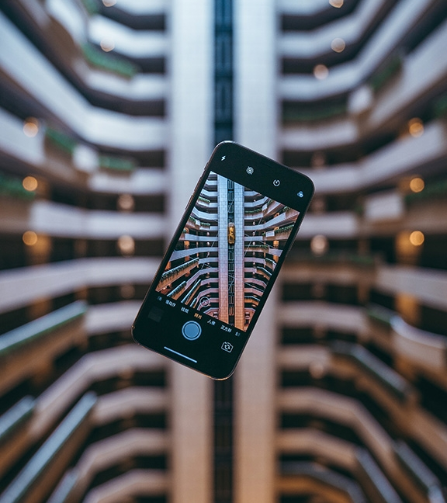
Table of content 1) Introduction 2) Functionalities 3) tools and technologies 4) architecture design 5) e-r diagram 6) working 7) implementation

Slide 4
introduction
HOTEL MANAGEMENT SYSTEM
The theme of my Project is Hotel Management System. This Project is a fine thought to make the complex procedure of the Hotel management system to an easy manner which is systematic, modular designed, selective menu based user display. The modular design and constructed system is very much user oriented in which user can easily understand the tools and can do edit of his own choice. The system is not any tough more and does not possesses many applications but it is made by focusing on the maintaining records employee’s actions in a computerized system rather than time taking and cumbersome manual system.
The project is a software application that can be easily handled by minimum educated and simple computer knowledge person without any option of error. Two kinds of users can handle the system.
1. Online Users
2. Administrator or Hotel Management.

Slide 5

FUNCTIONALITIES
The application of the Hotel Management System bears the following functions to use by the Administrator.
1. Hotel Details
2. Room Booking
3. Check-in and Check-out policy details
4. Admission of new customer
5. Check-out of customer
6. Room assigning related to customer’s need
7. Statement of customer details
8. Check-in customer
9. Check-out customer
10. Bill generation
11.Room details
12. Total number of customers in the hotel
13. Individual customer report
………………

Slide 6
Tools and technologies
TOOLS
TECHNOLOGIES
The following tools are used for The Hotel Management System
1. Eclipse
2. MySQL Workbench
The following technologies are used for The Hotel Management System .
1. JAVA
2. HTML
3. CSS
4. Bootstrap
5. JavaScript
6. Servlet
7. JSP

Slide 7
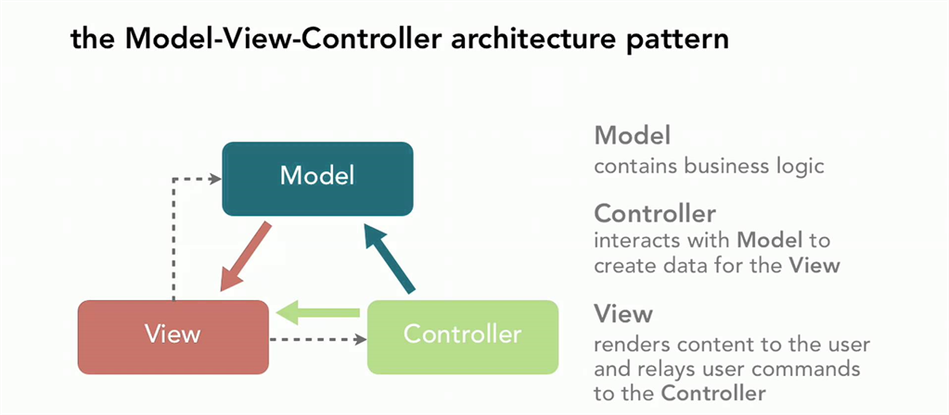
ARCHITECTURE
MVC
The Model-View-Controller (MVC) is an architectural pattern that separates an application into three main logical components: the model, the view, and the controller. Each of these components are built to handle specific development aspects of an application. MVC is one of the most frequently used industry-standard web development framework to create scalable and extensible projects.
Following are the components of MVC −
1. Model
2. View
3.Controller

Slide 8
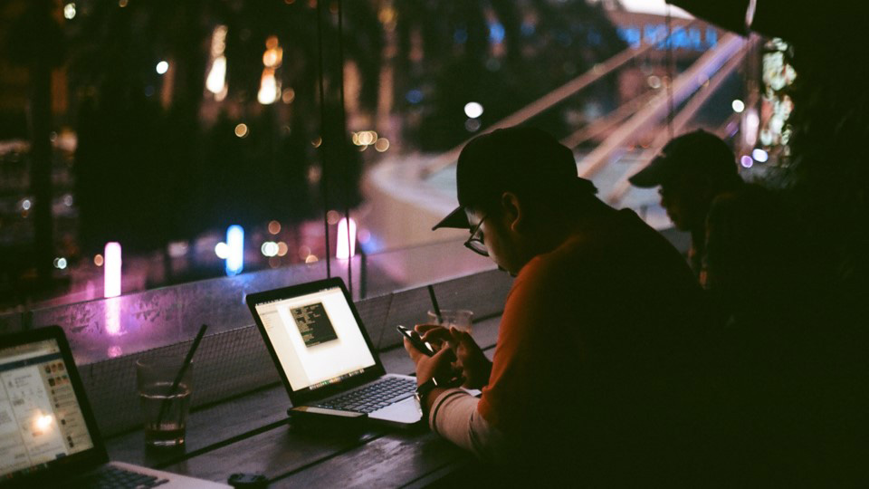

Slide 9
IMPLEMENTATION 1.hOTELS 2.HOSTELS 3.DORMITORY 4.RESORTS
……………………………

Slide 10
thankyou thankyou team delta

Slide 14
Customize this Template
Template Editing Instructions and Feedback

